Slide 1
HARLAN HIGH SCHOOL DUAL CREDIT
CLASS PRESENTATION

Slide 2
What is Dual Credit?
Dual Credit allows students to earn both high school and college credit simultaneously at their high school.
(Example: ENG III AP/Dual
( a course equivalent to 6 college hours: ENGL 1301 & ENGL 1302))
College credit is awarded as long as the student earns a 70 or higher each semester.
Awarding of college credit comes from a local community college (Northwest Vista College).

Slide 3
Dual Credit
Advanced Placement (AP)
There are limits as to how many courses a student can take throughout their high school career.
College credit is earned by passing each semester of the high school course (70 or higher).
Students must apply and take the TSI to qualify for Dual Credit courses.
Dual Credit can be awarded statewide (colleges in Texas), but students would have to check with colleges out of state.
There are no limits as to how many courses a student can take at a time..
College credit is earned by passing the AP test given in May of 2020.
There are no pre-test or application required to qualify for AP courses.
AP credit can be awarded nationally (colleges across the nation). Students should check with the colleges to be sure.
For BOTH, it is recommended that students check with their intended university to verify the credits will transfer.

Slide 4
Why enroll in Dual Credit courses?
Easier transition from high school to college
Greater likelihood of success in college courses
Greater likelihood of earning a high school diploma and a college degree
Reduced cost of enrolling in higher education courses
Dual Credit is an additional way to earn college credit!

Slide 5
DUAL CREDIT COURSES OFFERED AT HARLAN 2020-2021
English 3 AP/Dual
English 4 AP/Dual
English 4 Honors/Dual ***
Spanish 3 Pre AP/Dual
Pre Calculus Pre AP/Dual
Calculus AB AP/Dual
Calculus BC AP/Dual ***
US History AP/Dual
*** These courses are projected for the 2020-2021 school year but not yet guaranteed.
AP and Dual Credit Classes are stacked: students in DC classes will be receiving the AP
curriculum. Aside from earning DC, students will be able to take the AP exam to obtain college
credit as well.

Slide 6
Course Regulations
What should you expect as a Dual Credit Student?
You will be considered a college student!
The grade you earn in the course will follow you from this point forward on your college transcript.
It is the student's responsibility to know all important deadline dates when applying for the DC program.
If a student fails a Dual Credit course, the student will not be allowed to participate in any course where the failing course was a pre-requisite.
If a student drops a Dual Credit course after a certain deadline, the student may not take that particular course again until after graduation.

Slide 7
The Benefits-Cost
Example: ENG III AP/Dual (equivalent to 6 college hours: ENGL 1301 & ENGL 1302)
U.S. History AP/Dual (equivalent to 6 college hours: HIST 1301 and HIST 1302)
***For this one year, this student will earn 12 college credit hours!
Earned by Dual Credit at Harlan H.S.: FREE
Earned at:
Community College (ex. NVC, SAC) – approx. $1188 for 12 hours (just tuition)
Public University (ex. UTSA, TAMU, Texas Tech) – approx. $4,950 for 15 hours
Private University (ex. St. Mary’s, Baylor, OLLU) – approx. $15,000 for 12 hours
All above tuition amounts are based on 2018-2019 tuitions/fees

Slide 8
HOW DO I BECOME ELIGIBLE?
There are a couple different steps you will take to become eligible for dual credit:
Use the Dual Credit Checklist and follow the process
Complete the HHS Dual Credit Documentation and Signature Page
Complete the application (a.k.a. ApplyTexas)
Complete the Parent Consent Form and submit to your ACES account
Complete the GoFAARR/Test Prep Modules (will get access 2-3 days after application of ApplyTX)
Complete and earn eligible TSI scores
Complete the online dual credit orientation

Slide 9
COMPLETING THE APPLICATION
Instructions for every step can be found on the Dual Credit Website or you can go by B100 to pick up a packet.
We will be hosting application help sessions in January and February:
At the end of the presentation you will sign up for my classroom so that you will get reminders of help sessions and deadlines

Slide 10
TSI TESTING
Requirement that determines eligibility to take college level courses.
The cost is $14 for the initial test. If an ineligible score is earned, a student can retake the test at the same cost of $14 at a later date.
Administered at Harlan HS on:
o March 3, 2020 at Harlan HS (School Day)*
o March 4, 2020 at Harlan HS (School Day)*
o March 5, 2020 at Harlan HS (School Day)*
o Retest dates will be announced
o These dates are tentative; more dates could be added
*You may only take the TSI on ONE school day
**Retests are only for students who have already attempted the TSI

Slide 11
IMPORTANT DATES AND DEADLINES
*Note: Any changes to these deadlines will be announced. All deadlines are enforced.
December 17-20, 2019- Class presentation on dual credit (World/US History and Spanish 2)
January 8, 2020- Dual Credit Parent Night @ 6:30pm
January 15, 2020- HHS Dual Credit Document and Signature Page Due (Turn into room B100)
January 27-29, 2020-Apply TX Help Session (8:15 AM, 4th & 6th Lunch)
January 30, 2020- Apply TX Deadline (Turn into room B100)
February 11-13, 2020- Modules Help Session (8:15 AM, 4th & 6th Lunch)
February 14, 2020- Modules and Parent Consent Form Due (Turn into room B100)
February 19-21, 2020- TSI payment taken during 4th and 6th Lunch in B100 (Due by the 21st)
March 3-5 2020- TSI School Day (Tentative Date)
March 31, 2020- Online Dual Credit Orientation Due

Slide 12
STUDENT EXPECTATIONS
Please remember that these are college level courses, so these grades will factor into your college GPA as well as your high school GPA.
The class is more demanding, and the expectations are higher.
Students should be prepared and willing to work hard to meet the challenges of the Dual Credit Course.
Attend Prep Days and make sure that the correct classes are on your Harlan schedule as well as your ACES account!

Slide 13
LETS REVIEW THE PAPERWORK
Checklist (RETURNING and NEW to the program)
HHS Dual Credit Documentation and signature page--First thing to turn in

Slide 14
Please sign up for the Dual Credit
2019-2020 Google Classroom
All steps have been uploaded on the google classroom. Deadline reminders will be sent out and help session dates will also be posted. Make sure and check your classroom frequently!
New to Dual Credit Join Code: 4plwqds
Currently in Dual Credit Join Code: v7rr6b

Slide 15
Are you on Twitter?
Follow us for updates on Dual Credit and AP information:
@Ms_Eure
@HawkAP

Slide 16
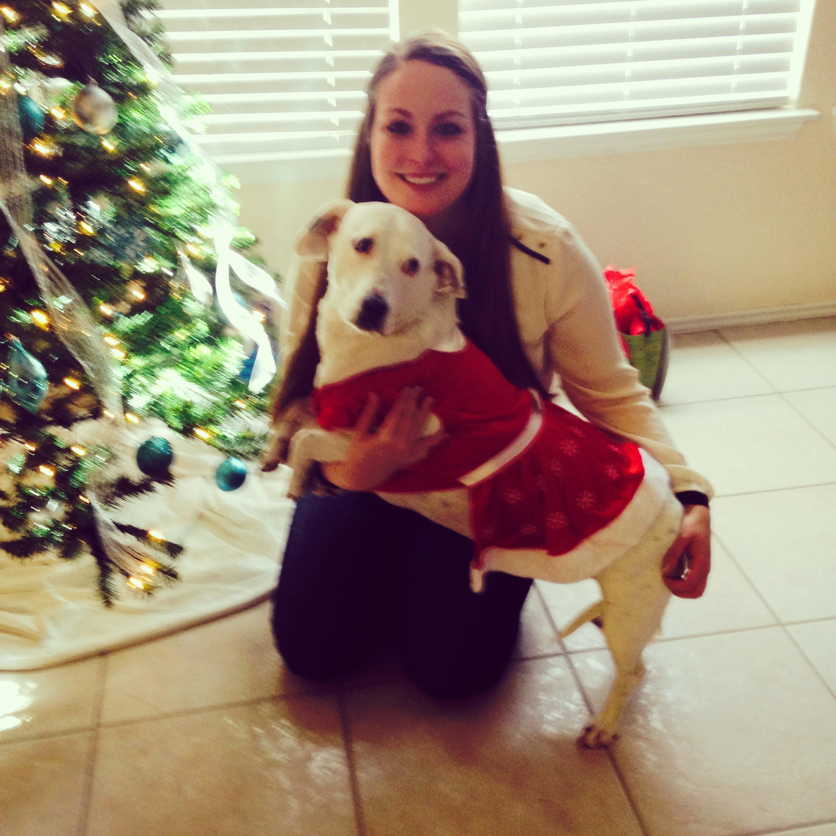
Dual Credit Enrollment Packets are available, please see:
Brittany Pettis
Student Success Advisor/Dual Credit Liaison
Harlan High School
Office : B100
Phone: 210-398-2241
Brittany.Pettis@nisd.net

Slide 18
THANK YOU FOR YOUR TIME! Questions???

