Slide 1
Apply Texas
◆ Apply at : www.applytexas.org
◆ Click on GET STARTED!
◆ Complete your Profile then click SAVE and wait for the rest of the class.

Slide 2
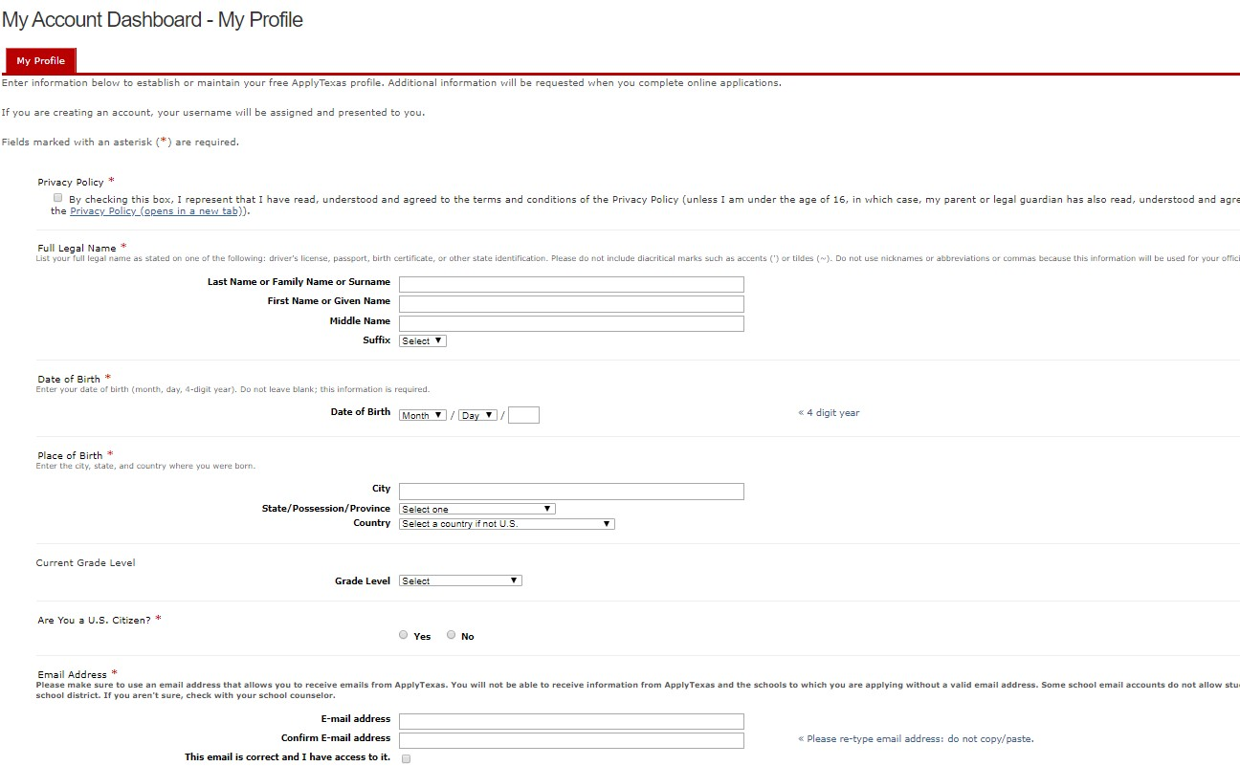
My Profile:
Agree to the Privacy Policy and enter in your personal information. It will take you several minutes
to complete the My Profile page. Please take your time and enter in your information accurately.
Agree to the Privacy Policy.
✓
Do not use nicknames or abbreviations.
Enter your full, legal last, first, and middle name.
This information will be used for your official
college record.
Do not use your high school email!
Enter your personal email address or your parent’s email address.

Slide 3
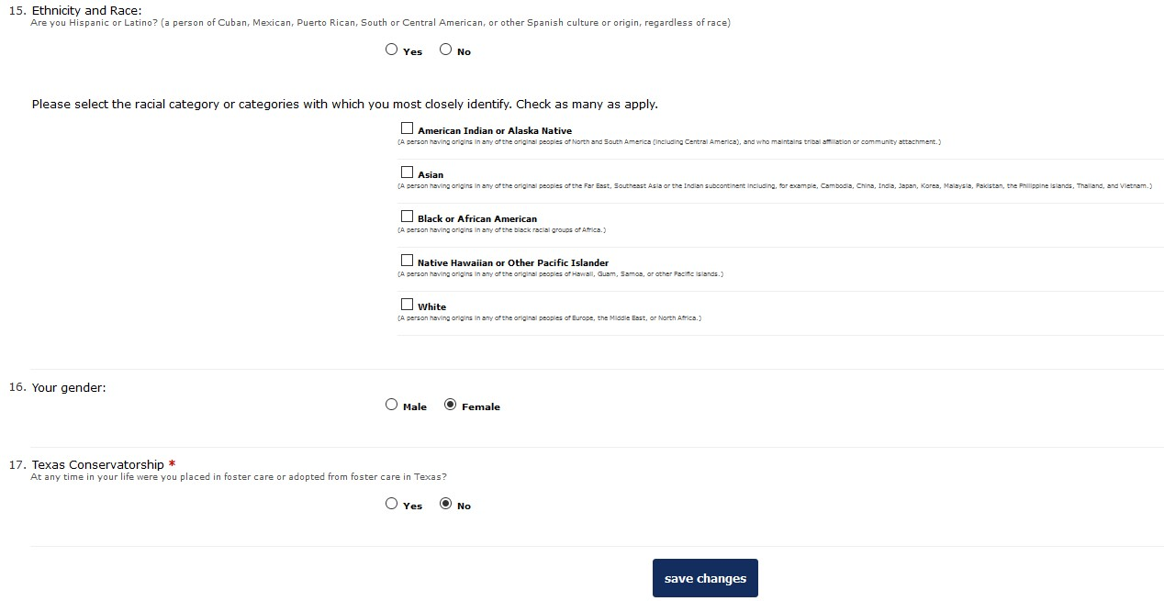
My Profile:
Answer the questions about Ethnicity and Race and Your Gender using the race and gender that you
identify yourself as.
Were you ever placed in foster care or
adopted from foster care in Texas?

Slide 4
Please Write or Photograph your :
◆ Application ID: Located in the middle of the screen.
◆ User Name : Located on the upper left side of the screen.
◆ Password: The password you just created.
Note: You will receive an automated e-mail from Apply Texas titled “Your Apply Texas Profile."
This e-mail will be sent to the email address you enter on your profile. This email is NOT
verification that the application has been completed or submitted.

Slide 5
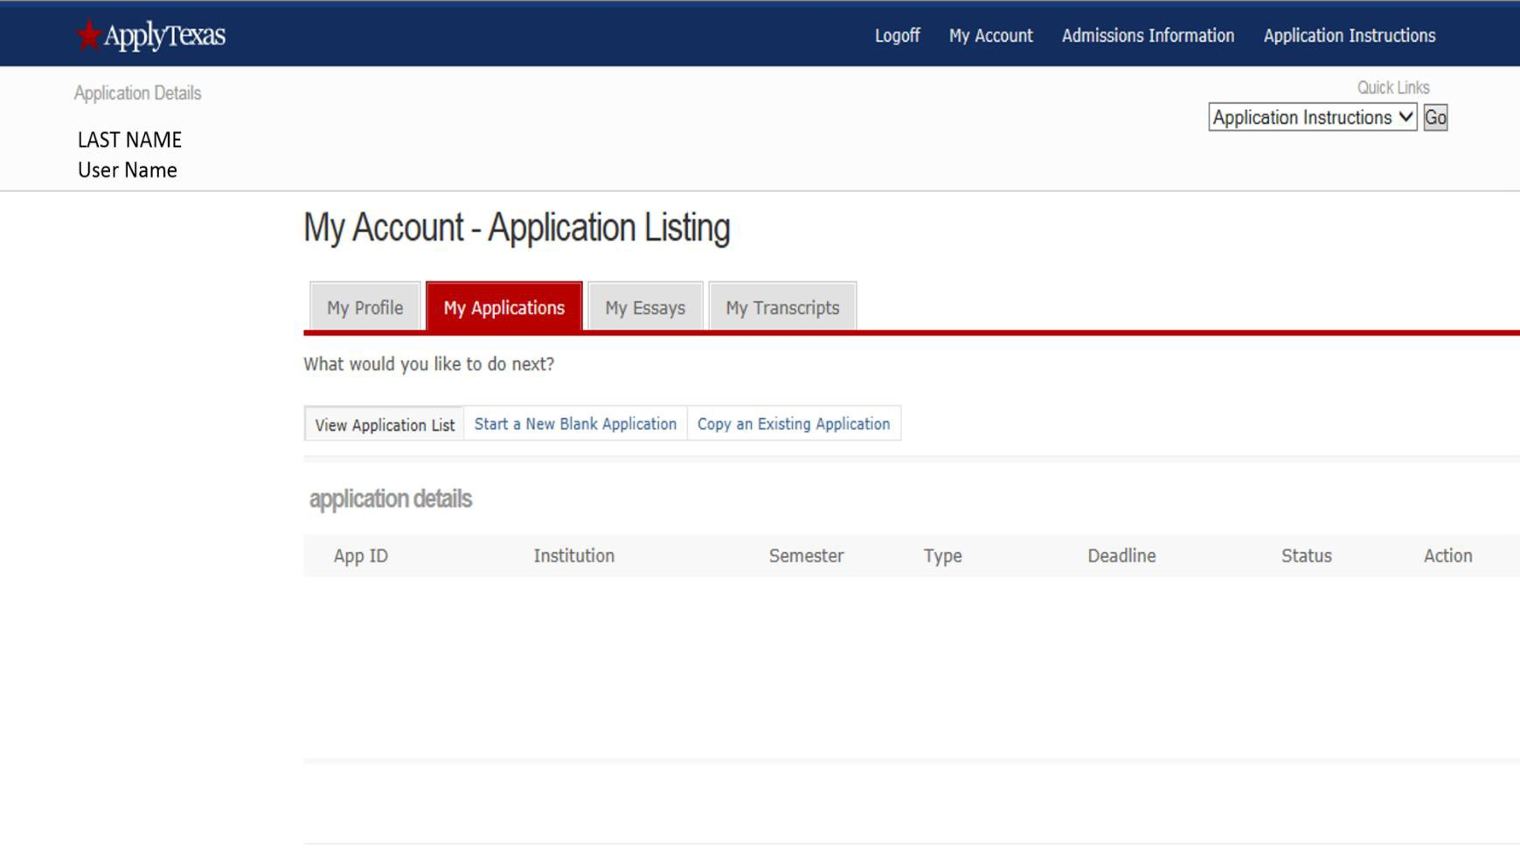
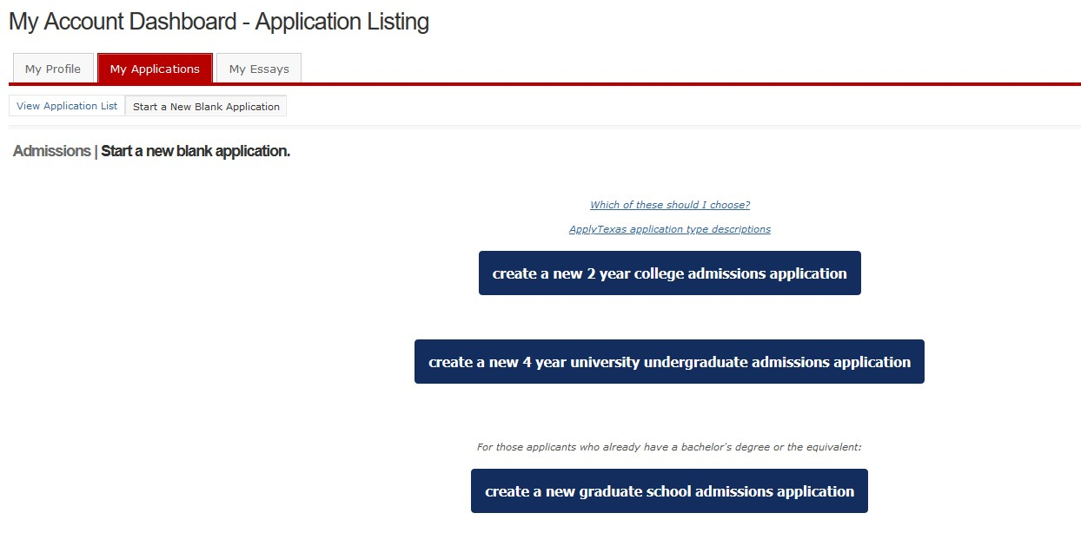
My Account:
Click on the My Applications tab and the Start a New Blank Application link.
Select create a new 2 year college admissions application.

Slide 6
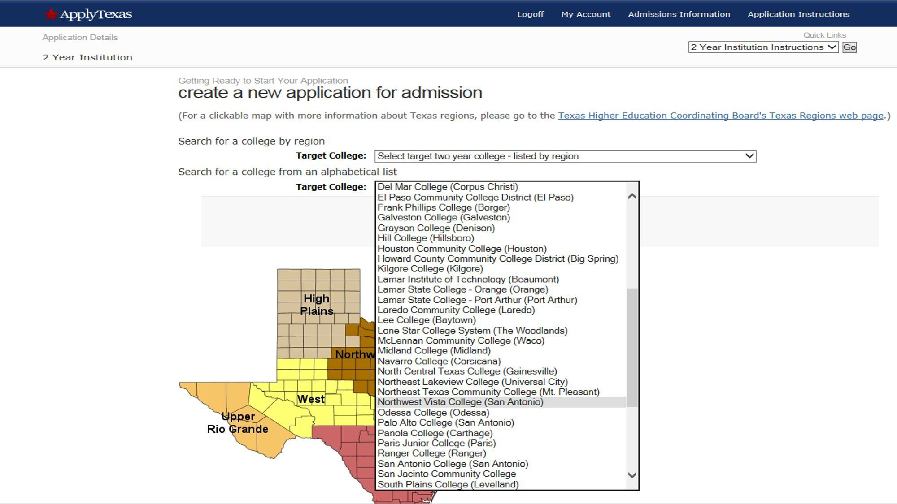
Select Northwest Vista College.
Northwest Vista College

Slide 7
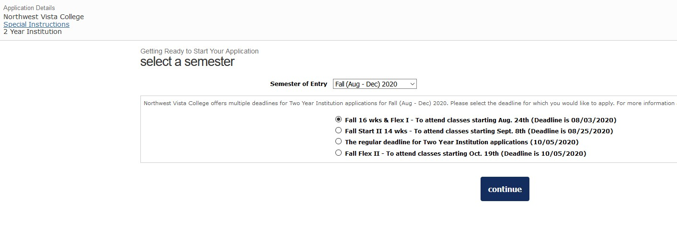

Select a semester:
Select Fall 2020 as the Semester of Entry from the drop down menu and Fall 16 wks & Flex I from
the options listed. Selecting the wrong semester of entry will impact the college’s evaluation of your
participation in the program. Please select Fall 2020 and Fall 16 wks & Flex I only.
Fall 2020
Note: Choosing the wrong semester will impact the college's evaluation of your participation in the program. Please choose correctly.

Slide 8
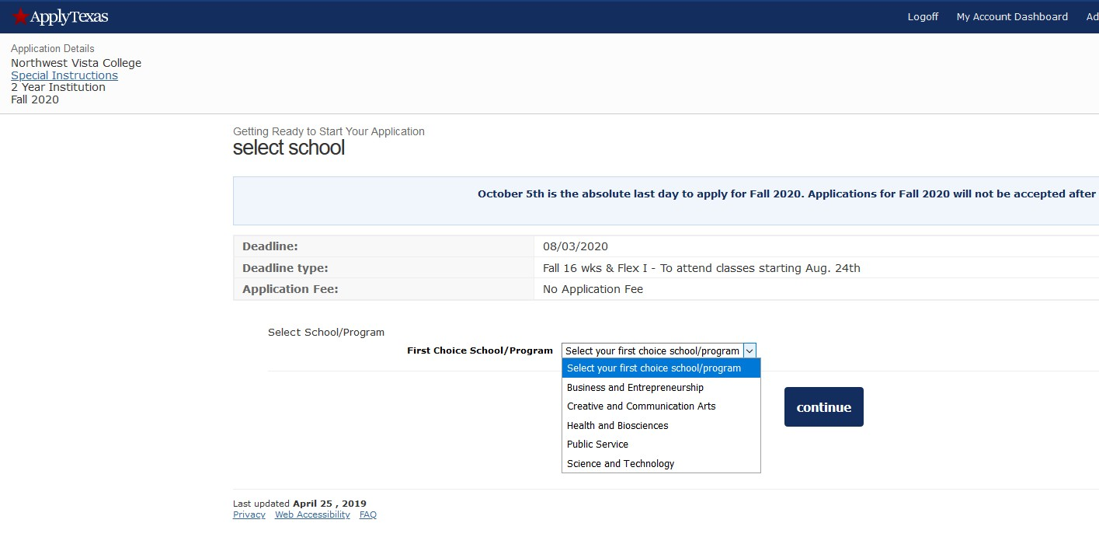
Select a School
Select the your first choice school that aligns with your high school endorsement. Please choose
correctly.

Slide 9
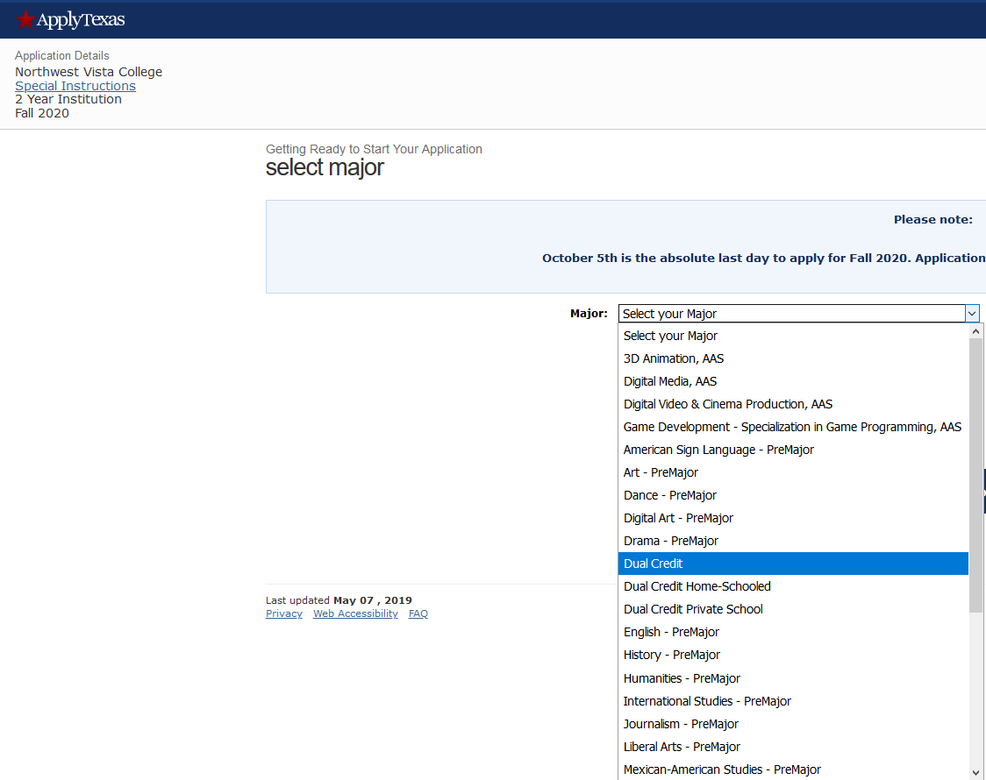
Select a Major
Select Dual Credit as your major.
Choosing any major other than Dual Credit may prevent your application from being received before the
deadline.

Slide 10
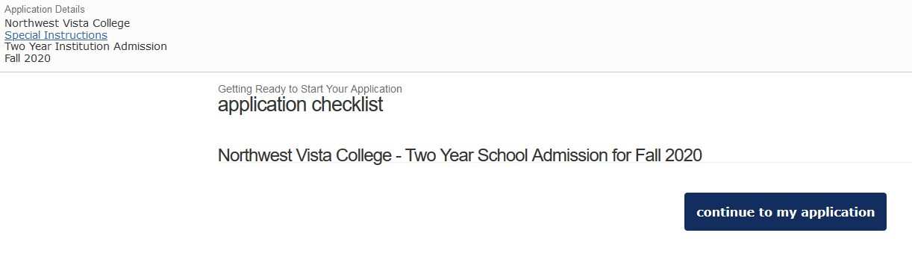
Application Checklist
Verify that you have selected the accurate application term (Fall 2020), then continue. If the application term listed is incorrect, select “go back” to update the term.

Slide 11
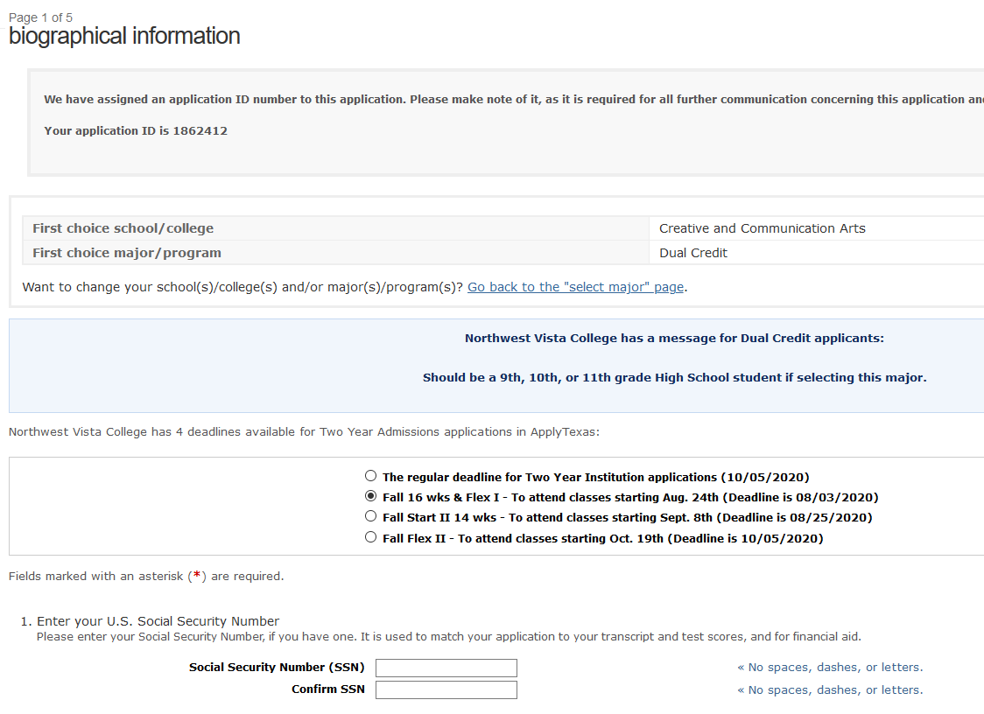
Biographical Information
The information on this page will auto-populate from the information you provided in your profile. Please scroll through and ensure all information listed is correct.
Social Security Number:
You must enter the correct SS#. This is important for purposes of the identity of your application and college record. Errors will affect your ability to retrieve your ACES and Banner ID.

Slide 12
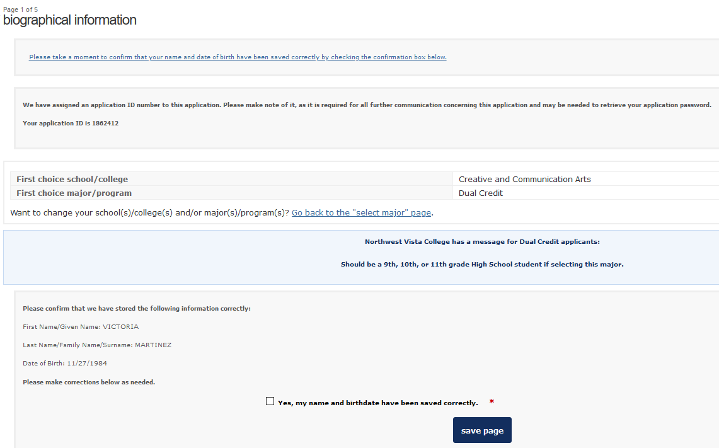
Biographical Information
Check for accuracy! Make sure the major listed is Dual Credit and confirm that your name and date of birth are correct. Select “Yes, my name and birthdate have been saved correctly” and save page.
✓

Slide 13
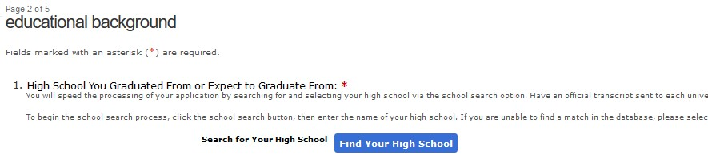
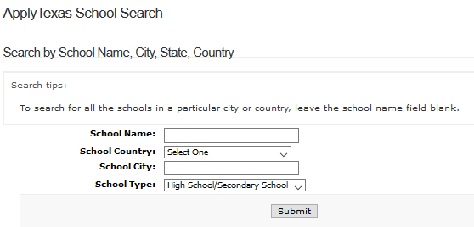
Educational Background
Click on “Find Your High School”. The search window will open where you will enter the name of your high school in the School Name field (leave all other fields blank) then click on Search.
Search Results will display high schools that match the school name you entered. From the list of results, select the high school with the correct name, address, and city.
John M. Harlan
San Antonio

Slide 14
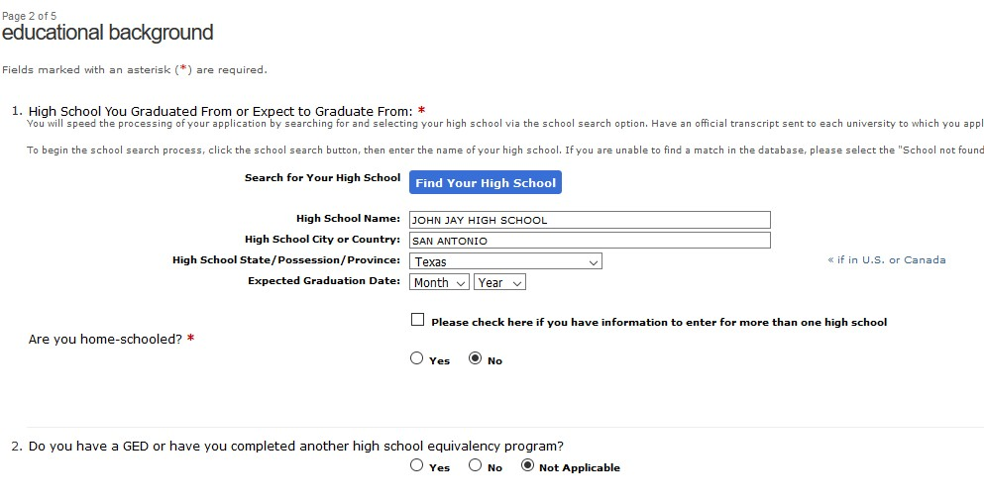
Educational Background
High School Name, City, and State will auto-populate. Enter your Expected Graduation Date.
John M. Harlan
Graduation Date:
June of what year?

Slide 15
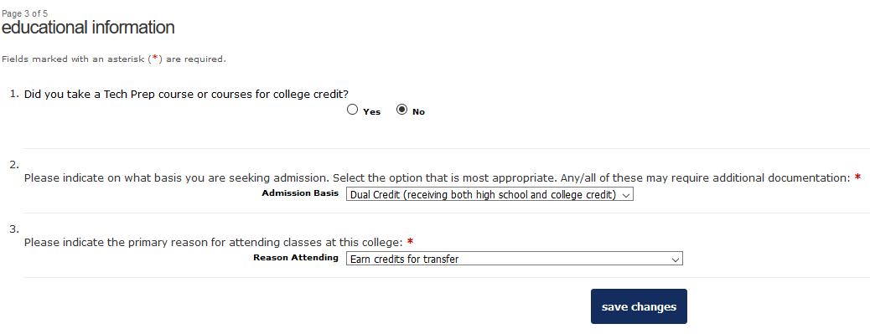
Educational Information

Slide 16
Residency Questions
If possible, have your parents or legal guardian guide you
with the correct answers.
The following questions will be about Taxes, Employment,
and State of Residency.

Slide 17
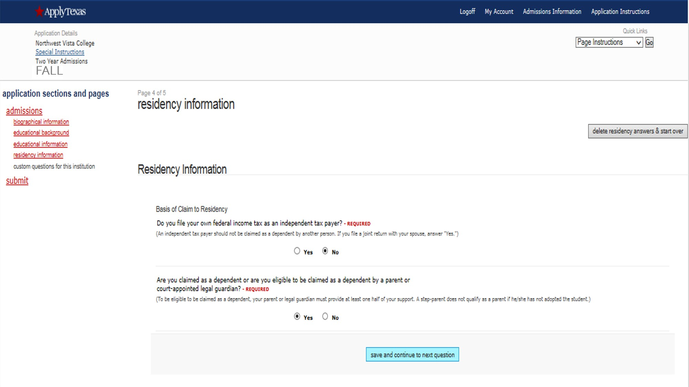
Residency Information
Students are typically not independent tax payers.
Please select “No”.
Students are typically eligible to be claimed as a dependent.
Please select “Yes”.

Slide 18
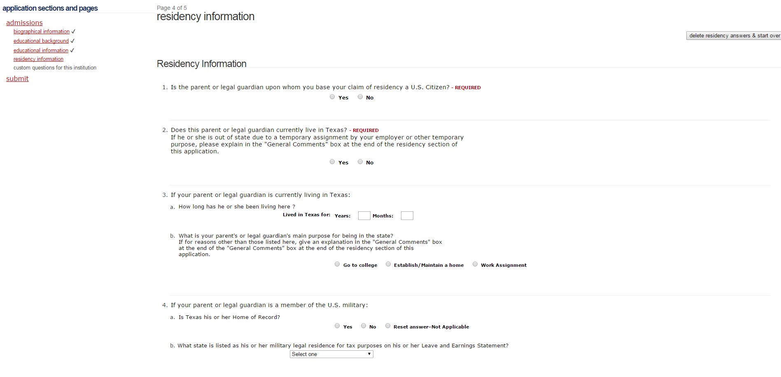

Residency Information (continued)
If you have lived in Texas all of your life, estimate your parent’s age and enter as answer.
Go to College – Your parent is only temporarily living in Texas to attend college and will be moving back out of state.
Establish/Maintain a home - Your parent lives in Texas and has established a permanent residence.
Work Assignment – Your parent is only temporarily living in Texas for a work assignment and will be moving back out of state.

Slide 19
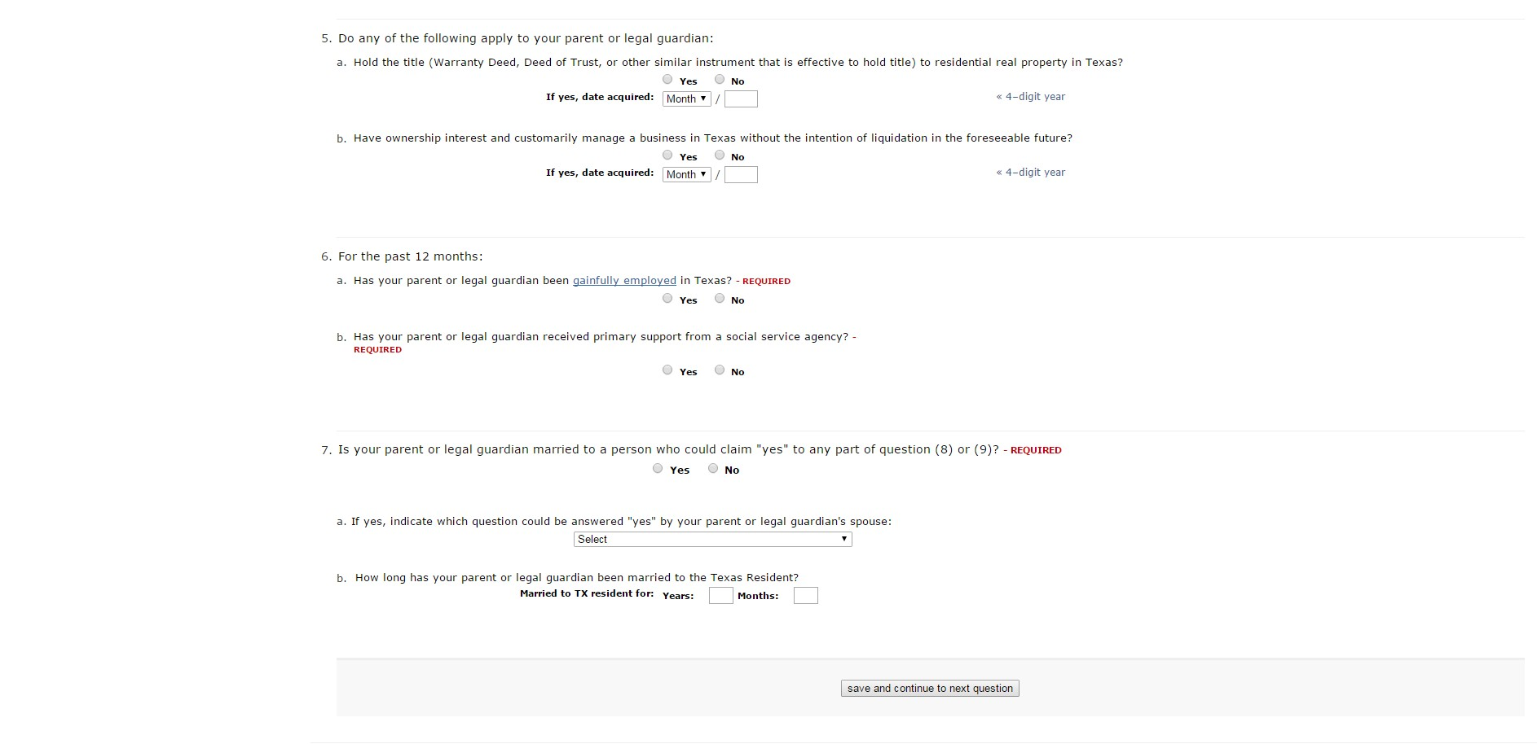
Residency Information (continued)
Does your parent have a job in Texas?
Does your parent receive government assistance such as disability checks or food stamps?
Are your parents married? Yes or No? If you answered No, skip a. and b. - you have completed all of the Residency questions.
Click save and continue to next question.
If you answered Question 7 as “Yes”, select Gainfully Employed from the drop down menu if one of your parents has a job in Texas.
How many years have your parents been married? This is just an estimate. If your parents have been married all of your life,
enter your age for the answer to this question.

Slide 20
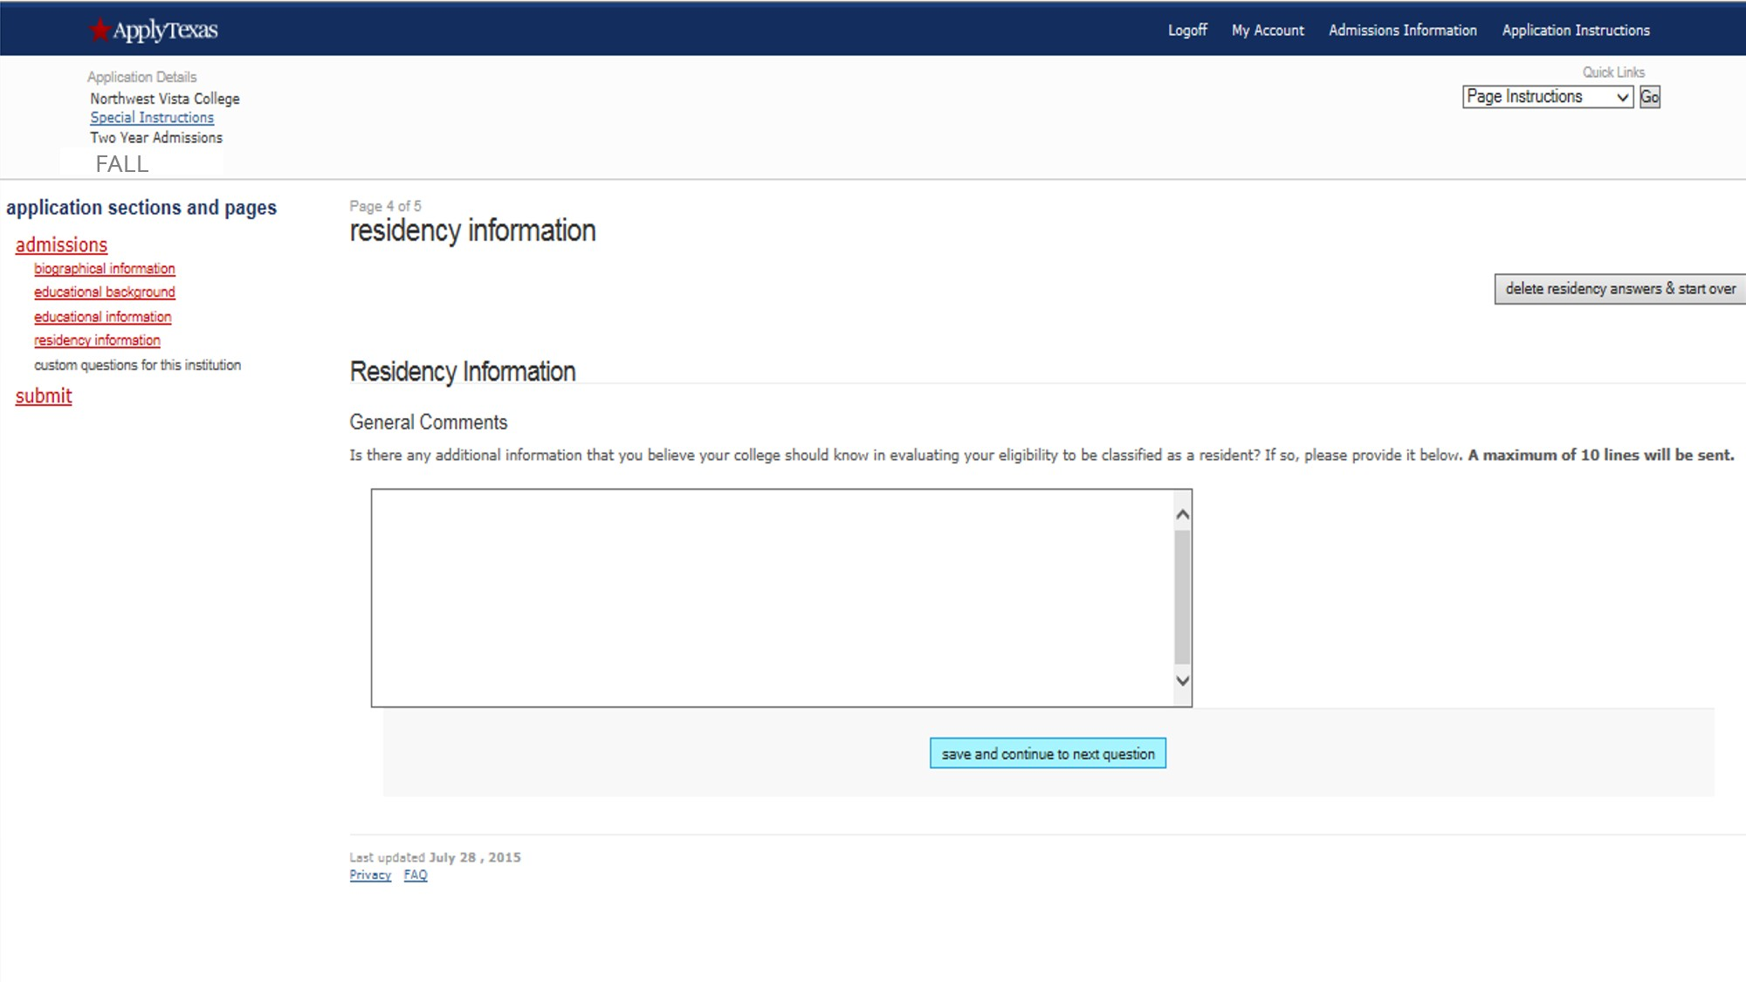
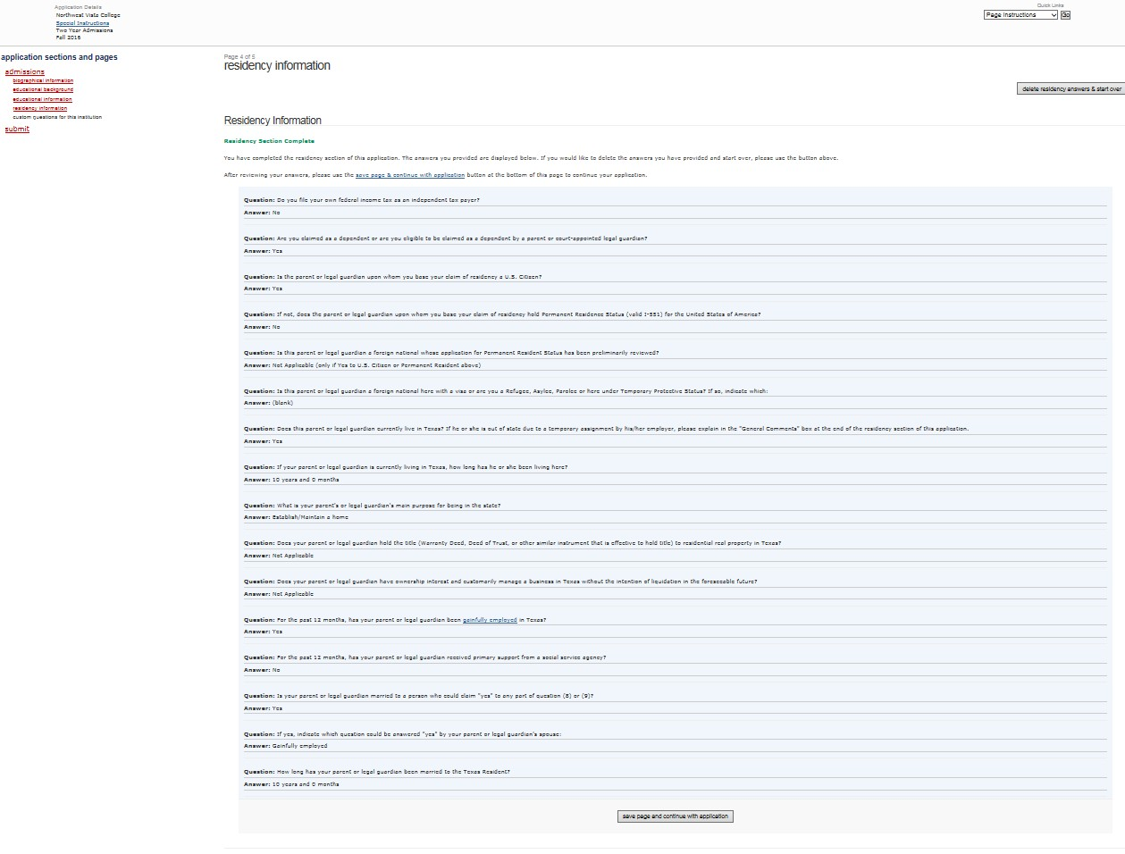
Residency Information (continued)

Slide 21
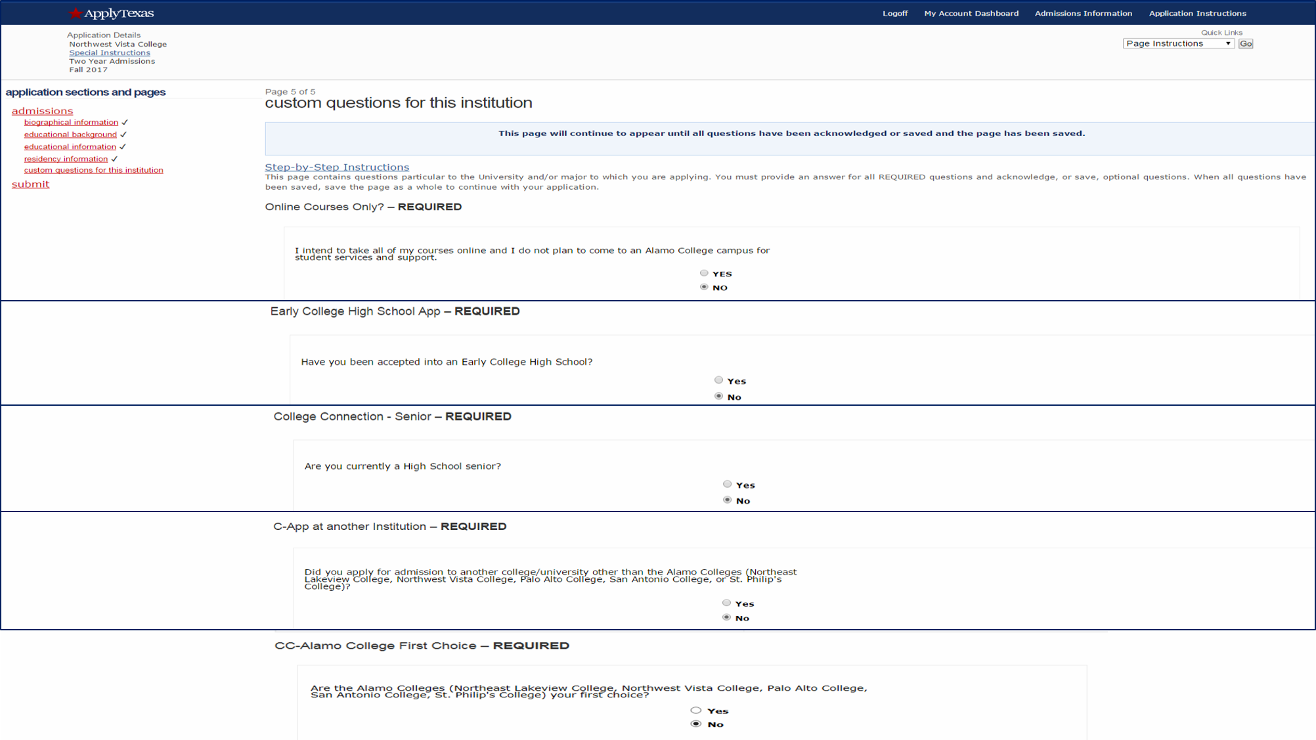
Custom Questions for this Institution
If you are a senior who plans to attend the Alamo Colleges after high school graduation, you will be required to complete a new Apply Texas application as a high school graduate. At that time, you will answer Yes to this question.

Slide 22
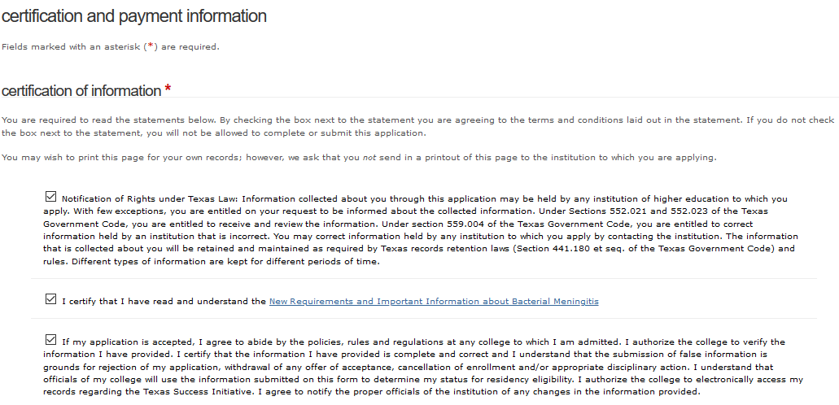
Certification of Information

Slide 23
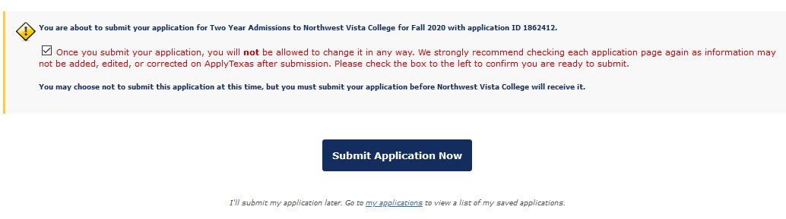

Submit Application
Bring a copy of the 1st page of the submitted application to B100! (You can print in B100, if needed)
Write, print, or photograph the following information for your records:
Application ID
User Name
Status
Note: Status must be “Submitted”. A status of “Saved” means that your application has not been sent to Northwest Vista College.

Slide 24
Congratulations on submitting your
application to Northwest Vista College!
Your next steps:
Wait 3-5 days for your application to process
Complete Go FAARR and Test Prep Modules in ACES
Take the TSI exam -OR- request your official SAT/ACT scores
Complete the Dual Credit Student Orientation in Canvas (on ACES Homepage).

